Slide 1

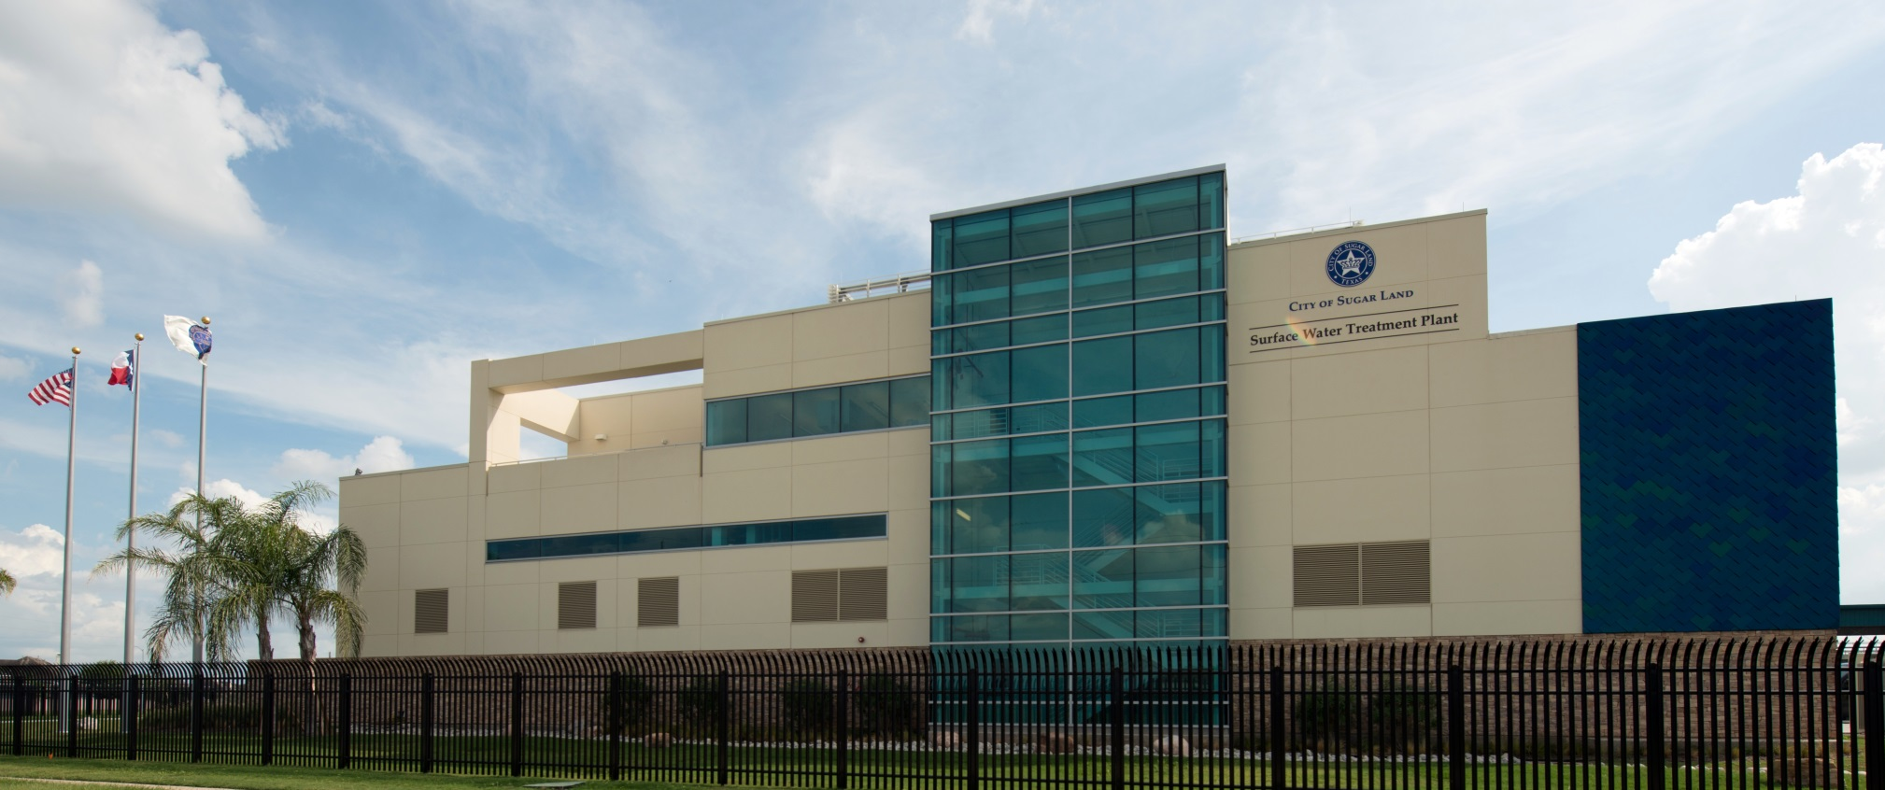
Groundwater Reduction Plan Participant Meeting November 19, 2025

Slide 2
2025 Participant Meeting
Introductions
Fort Bend Subsidence District Update
GRP Implementation and What’s Coming Next?
FY26 Update

Slide 3


Fort Bend Subsidence District
Veronica Osegueda
Deputy General Manager

Slide 4

Fort Bend Subsidence District
The Fort Bend Subsidence District (FBSD) is a special-purpose district created by the Texas Legislature in 1989 to prevent further land subsidence in Fort Bend County.
GROUNDWATER REGULATION
RESEARCH & MONITORING
WATER CONSERVATION
Collaborate with local to state water entities and providers to manage groundwater use through water planning and well permitting.
Utilize the highest quality data to monitor groundwater usage, aquifer characteristics, and land surface changes.
Provide permittees, businesses, and educators with water conservation tools to reduce water use and empower the community to value water.
4

Slide 5
FBSD Regulatory Areas
Area A: no more than 40% of Total Water Demand (TWD) may be sourced from groundwater.
Permittees operating within an approved Groundwater Reduction Plan have the following requirements:
2013 – no more than 70% of TWD from groundwater
2027 – no more than 40% of TWD from groundwater
Area B: not subject to groundwater reduction requirements.
5

Slide 6
Groundwater Use
6
Notes:
Exhibit 8– Total Water Demand was 184.2 MGD up from 140.5 in 2021. Overall an increase of 31%.
GW 88.6 MGD up from 67.4 MGD increase of 32%
Brazos 67.9 MGD up from 53.3 MGD increase of 27%
San Jacinto/Trinity 20.5 MGD up from 15.4 MGD increase of 33%
Reuse 7.3 MGD up from 4.4 MGD increase of 65% with the biggest increase from Cinco MUD 1
1990 104.6 MGD

Slide 7
Total Water Demand
7

Slide 9
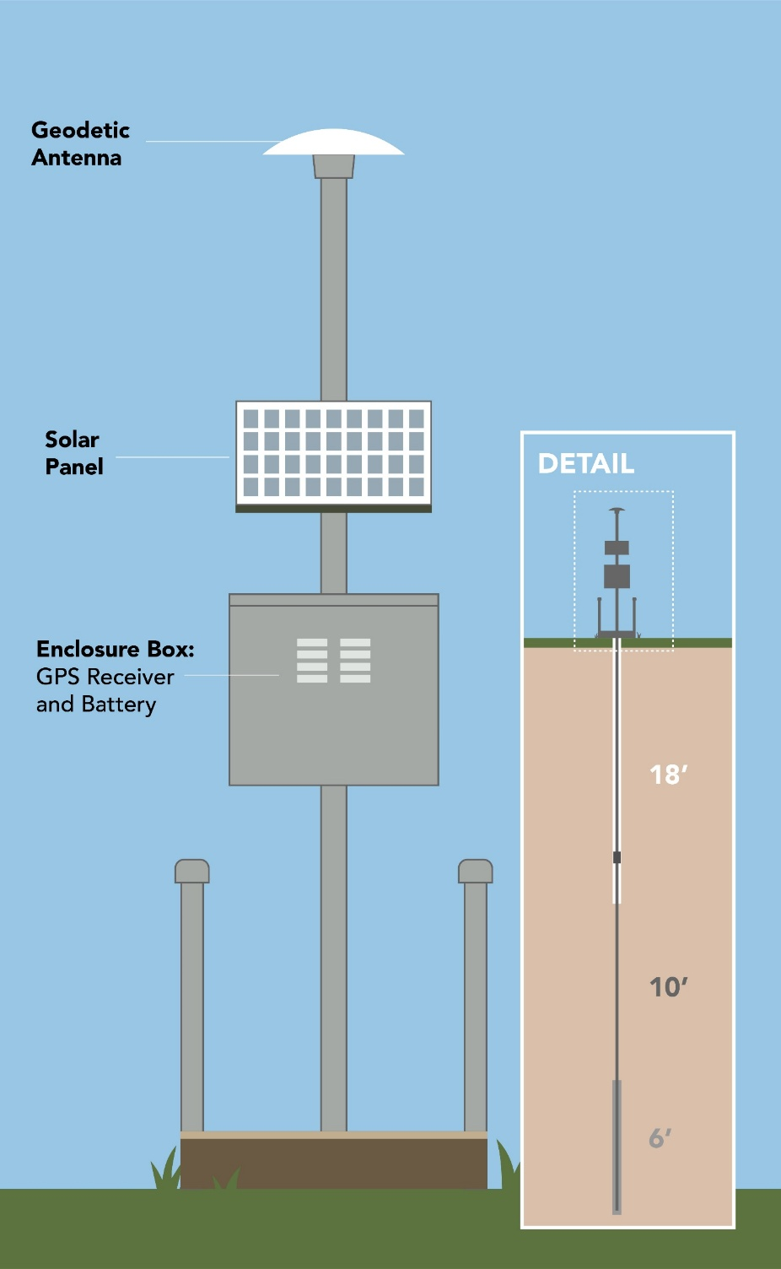
Subsidence Monitoring
All FBSD operated global positioning system (GPS) stations are constructed in a custom design.
GPS data are collected for one week every two months. A conversion to continuous monitoring (data collection every day of the year) began in 2023 and will continue through 2027.
9

Slide 10
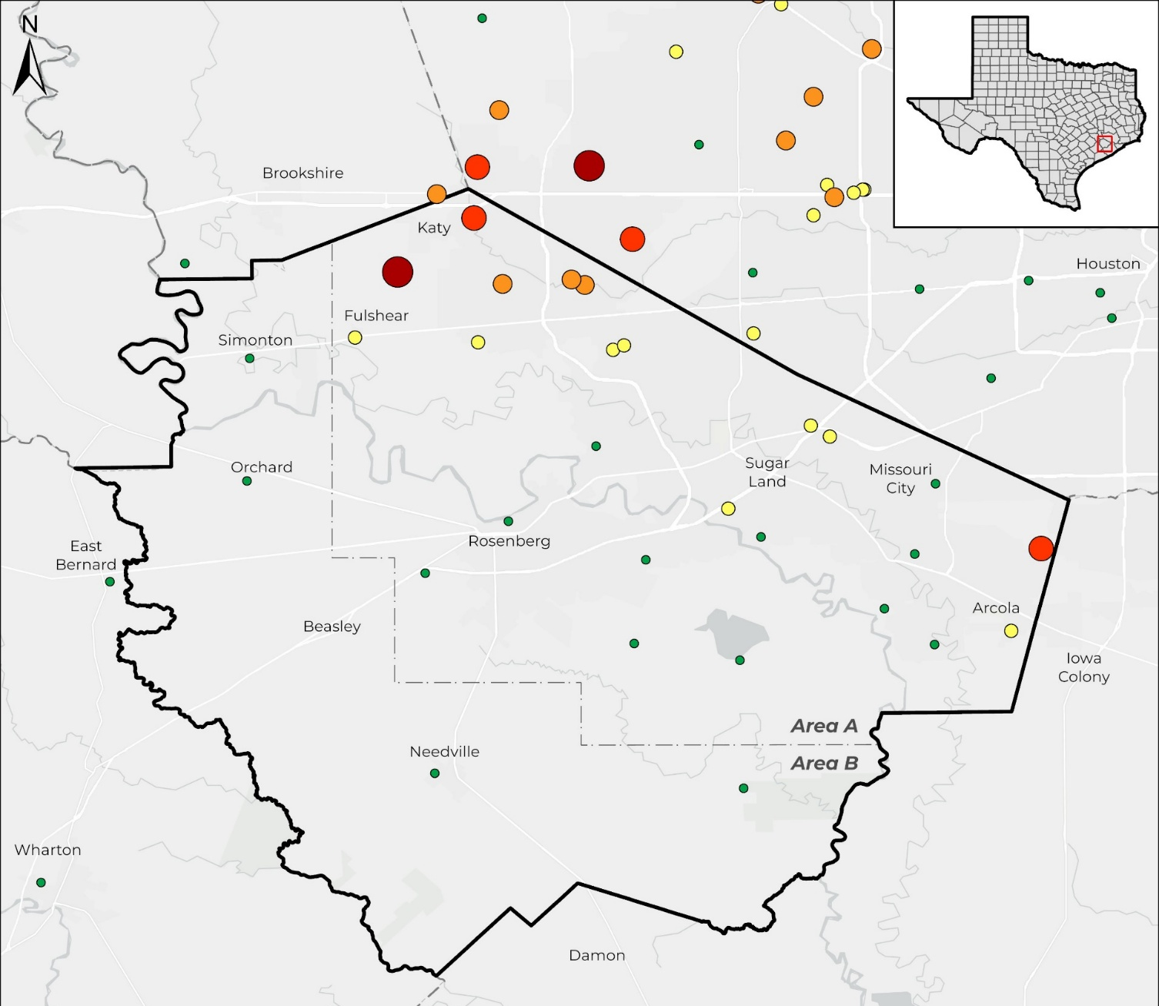
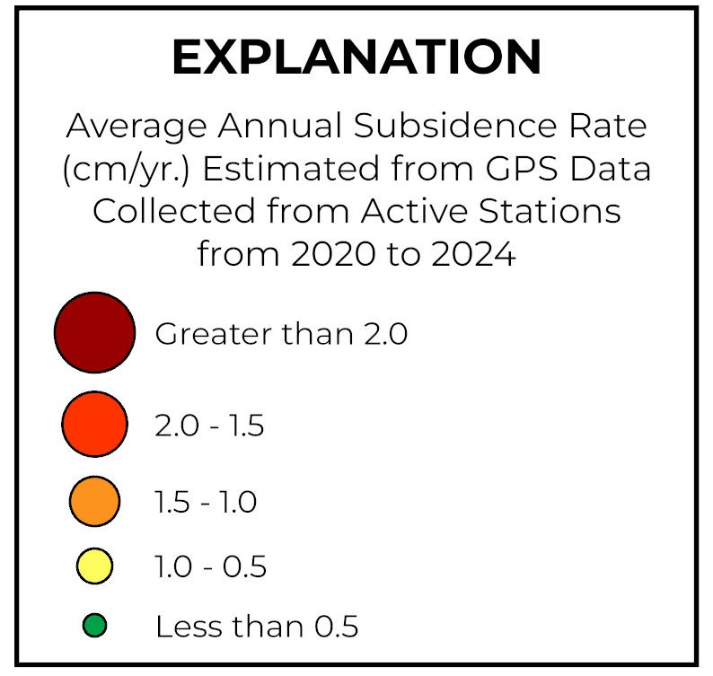
Subsidence Data | GPS Stations
Annual subsidence rate, in centimeters per year (cm/yr.), estimated from GPS data collected at active stations with three or more years of data averaged from 2020 to 2024.
10
Notes:
Subsidence Rate Map!

Slide 11
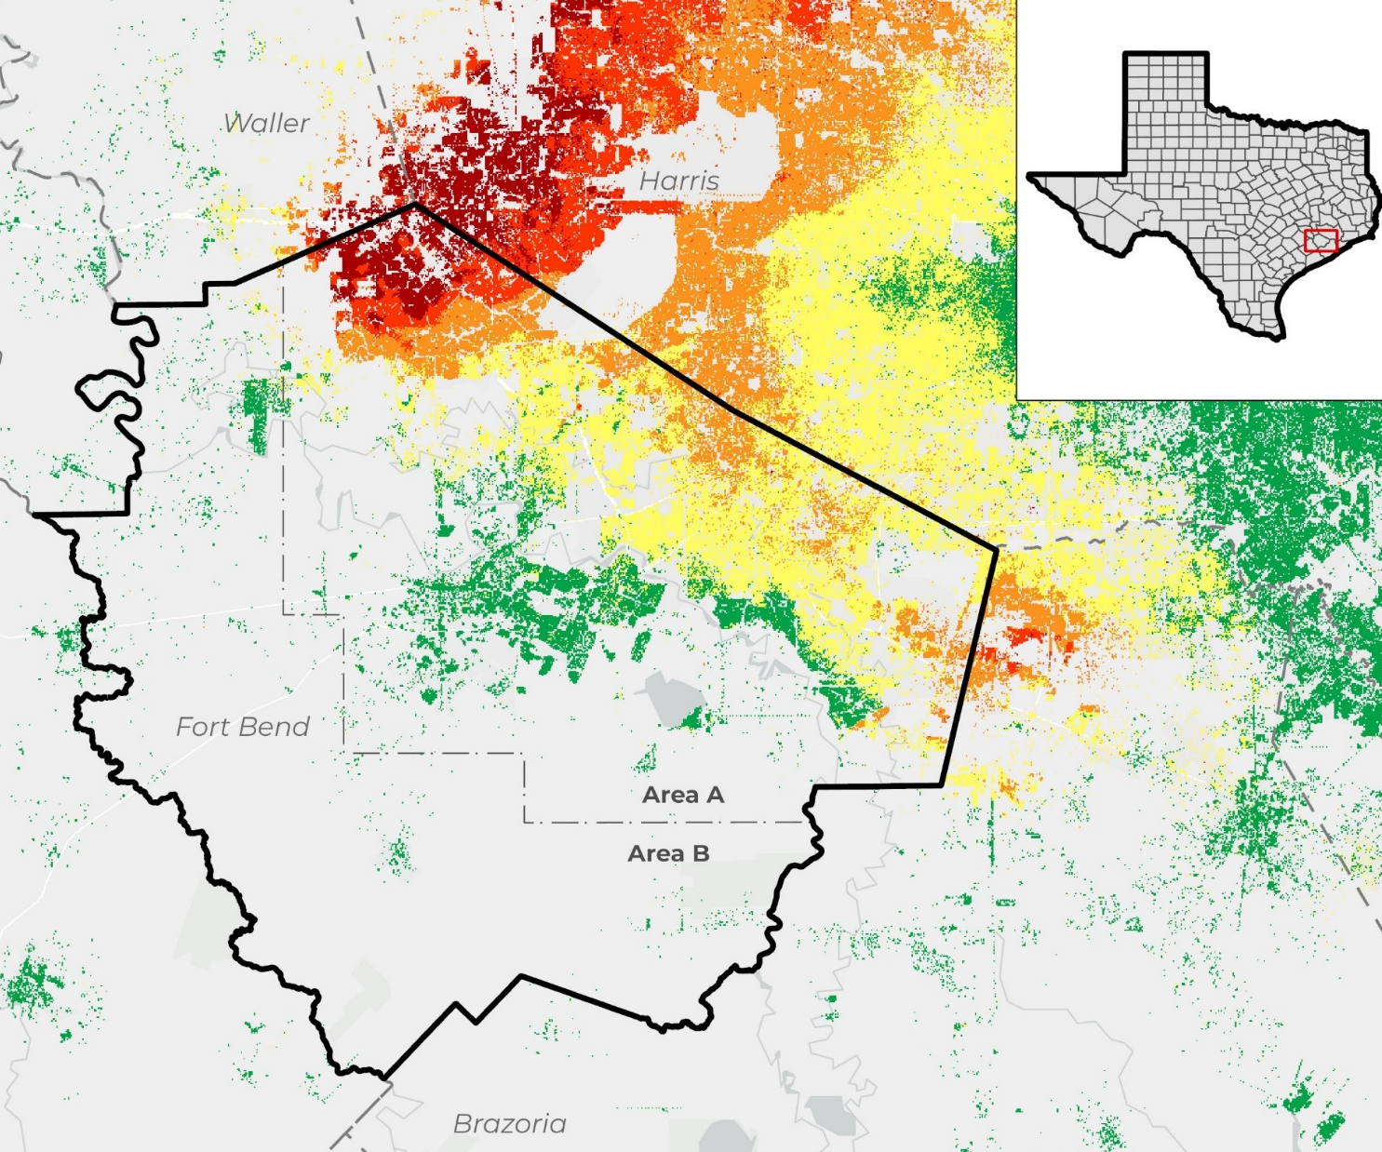
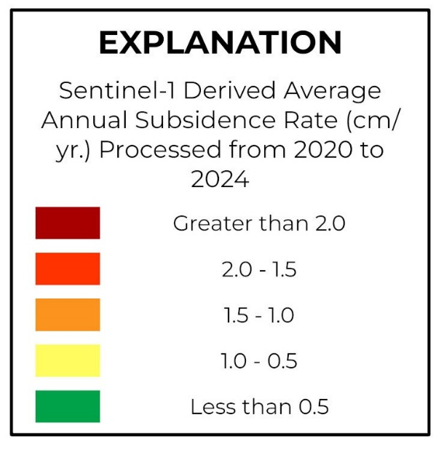
Subsidence Data | InSAR
Annual subsidence rate, in centimeters per year (cm/yr.), estimated from Sentinel 1A derived time-series interferograms averaged from 2020 to 2024.
*Gray areas indicate no data, as InSAR accuracy decreases in rural areas due to tropospheric errors and seasonal vegetative growth.
11
Notes:
Subsidence Rate Map!

Slide 12
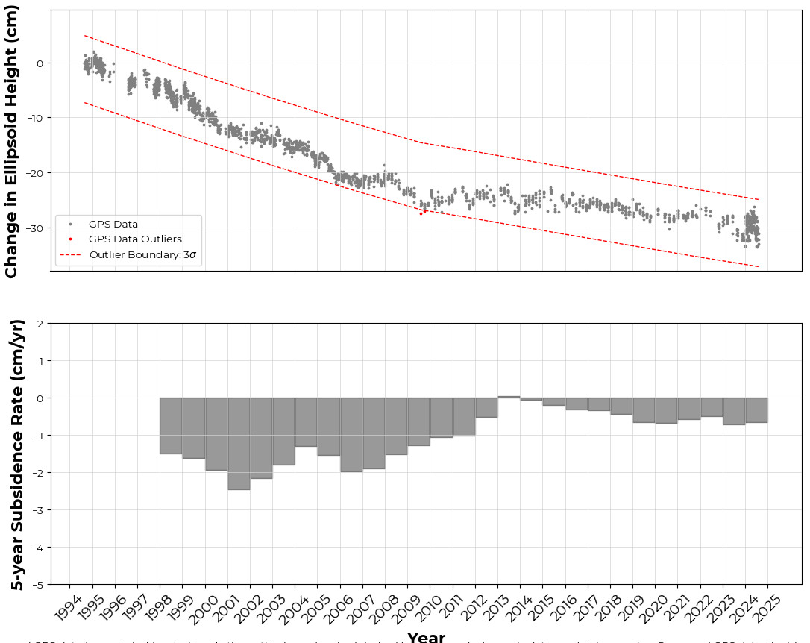
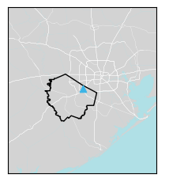
Subsidence Data in Sugar Land, TX
GPS station P004, located in Sugar Land, has measured a total of approximately 30.9 cm of subsidence since 1994.
2020-2024 average annual subsidence rate is 0.61 cm/yr.
Processed GPS data (source: UH) over period of record. Processed GPS data (gray circles) located inside the outlier boundary (red dashed lines) are used when calculating subsidence rates. Processed GPS data identified as outliers (red circles) are not considered by the District when calculating subsidence rates and are shown for informational purposes only.
12

Slide 13

Annual Groundwater Reports
FBSD Annual Groundwater Reports can be found on our website:
FBSUBSIDENCE.ORG/science
13

Slide 14
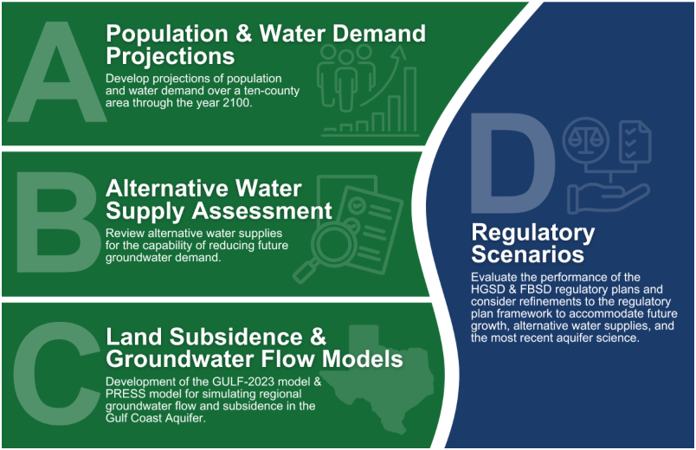

Joint Regulatory Plan Review (JRPR)
14

Slide 15
JRPR Findings | Subsidence
The District's Regulatory Plan sets a reasonable and attainable target for groundwater use within the District and has shown positive results in reducing subsidence rates.
Short-term projections (2025-2050) show the effectiveness of the current Regulatory Plan in minimizing subsidence within Fort Bend County.
Long-term projections (2050-2100) reveal additional subsidence in Area B and in the southern portion of Area A as well as along the border with adjacent counties to the south and north.
15

Slide 16
JRPR Findings | Future Planning
Most of Fort Bend County will continue to experience rapid population growth, with the largest areas of growth in Regulatory Area B and south of the Brazos River.
Alternative water supplies are available in sufficient quantities to support projected growth, though the source and time-to-delivery will vary within the District.
Additional resources will need to be dedicated to research and monitor the impact of groundwater use on subsidence in the areas of current and future growth.
16

Slide 17
Proposed Plan Amendments
Extend the deadline for conversion requirement to reduce groundwater to more than 40% of a permittee’s total water demand from 2027 to 2030
Establish a new regulatory conversion requirement for area B – groundwater reduction plans by 2035 and first conversion requirement to 70% groundwater in 2050.
Addition of conditions to maintain a viable groundwater reduction plan based on active monitoring of subsidence.
17

Slide 18
Contact Information
301 Jackson St. Ste 639
Richmond, TX 77469
(281)342-3273
fbinfo@subsidence.org
www.fbsubsidence.org

Slide 19
Groundwater Reduction Plan Implementation Update
Margo Watson
Water Resources Manager

Slide 20
GRP Historic Water Demand Million Gallons per Day (MGD)
FBSD Year Demand Conversion
April- March Actual Percent
2012-13 24.70 0.67
2013-14 25.03 3.38
2014-15 22.09 9.39 42%
2015-16 22.87 9.72 42%
2016-17 22.94 8.99 38%
2017-18 23.71 9.97 41%
2018-19 22.63 9.62 42%
2019-20 24.24 9.81 40%
2020-21 24.12 9.54 40%
2021-22 21.00 8.23 39%
2022-23 26.08 9.91 38%
2023-24 26.48 8.71 33%
2024-25 23.64 8.16 35%
Notes:
This chart shows total water demand and conversion rates starting in 2012 which was before the 30% alternative water conversion requirement. Since the required conversion in 2014, the GRP has consistently over converting. Therefore, we are in compliance with the current 30% alternative water regulations. As of Jan 1st 2025, we are no longer earning over conversion credits per the FBSD as that was the original 2nd conversion date to 60% alternative water.

Slide 21
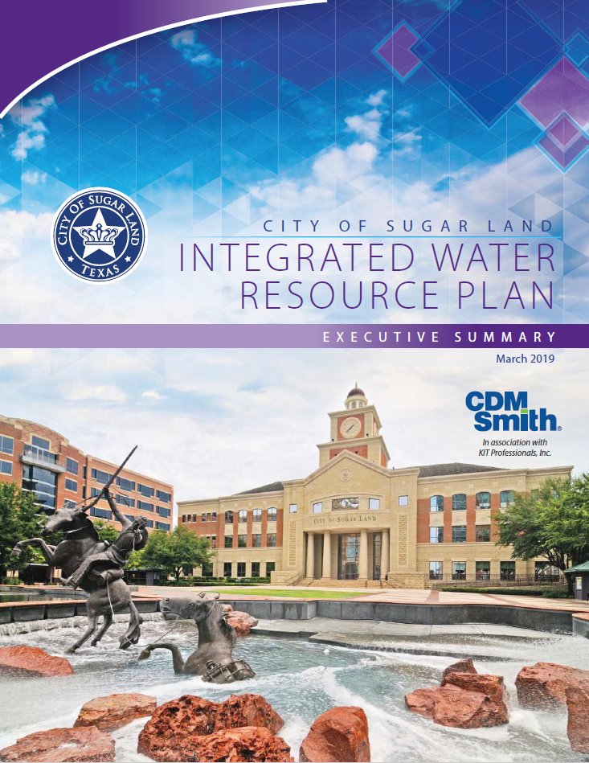
Integrated Water Resource Plan
Recommended by:
Council Task Force
Citizen Task Force
City Council- approved 3/19/2019
Recommended Projects:
Basic Conservation
Advanced Metering Infrastructure
Water Loss Control
Surface Water Treatment Plant Expansion of 5.5MGD
Expanded Reclaimed Water Facilities
Groundwater Credit Banking
Notes:
We will be starting an update of the IWRP in early 2026. Keep an eye out for communications looking for public input throughout the process. Having this long-term water supply plan allows us to
1. Remain in compliance with the FBSD regulations
2. Plan CIP projects for the future
3. Maximize our ability to offset CIP costs with our groundwater credit bank
4. Informing our council and community members

Slide 22
89th TX Legislature
Prop 4 (HJR7 and SB7) – passed Nov 4th by voters
Dedicated $1B in state sales tax to the Texas Water Fund
50% goes to New Water Supply
50% goes to other funds within the Texas Water Fund
Managed by the Texas Water Development Board
Other notable bills
HB157 (new TCEQ report about projected risks)
SB1967 (financing for flood mitigation + water supply)
HB29, SB1190, HB2605 (water loss)
Notes:
HJR7 and SB7 – adding funding for new water supplies
HB157 – directs TCEQ to prepare a report for each PWS looking at projected risks and recommendations for preventing unplanned downtime during disasters
SB1967 – created a financing pathway for combined flood mitigation + water supply projects
HB29 – water loss audit validations for municipalities serving 150k service connections
SB1190 & HB2605 – mitigation plans if municipalities exceed the expectations of water loss targets

Slide 23
AMI & Water Smart Portal
We are at 96% AMI installation meters
Water Smart portal progress is being made
Keep an eye out for further communications on when the portal will go live

Slide 24
Fiscal Year 2026 Update

Slide 25
GRP Philosophy
City Policy adopted in September 2002
Plan for the City and our ETJ
Surface Water Fund to Account for Costs
Costs of Surface Water Conversion Shared Equally among GRP Members
Blended Rate for all Members
All Participants Pay Based on Same Rates
GRP Participants avoid FBSD disincentive fee
$6.50 per 1,000 gallons

Slide 26
Rate Study Implementation Plan
Meet financial objectives for the Utility System
Fiscally responsible government
Focus on financial resiliency of the system
Where possible take steps to improve bond rating
Use Cash reserves to minimize rate increases
Use the groundwater credits to delay capital construction where possible
Build flexibility to address outcomes of ongoing initiatives (Delay SWTP expansion by 2 years)
Notes:
Did not raise GRP fees from 2014 to 2020 (6 years)
Did not raise W/WW fees from 2012 to 2020 (8 years)
Current plan: start construction of the SWP expansion in 2030 and use groundwater credit bank to offset until construction is completed

Slide 27
Fiscal Year 2026
In September, City Council approved rates effective January 1, 2026
GRP Fee $3.55
Surface Water Fee $3.81
3.0% Increase
Rate Adoption Letters went out last week
CIP projects are published online

Slide 28
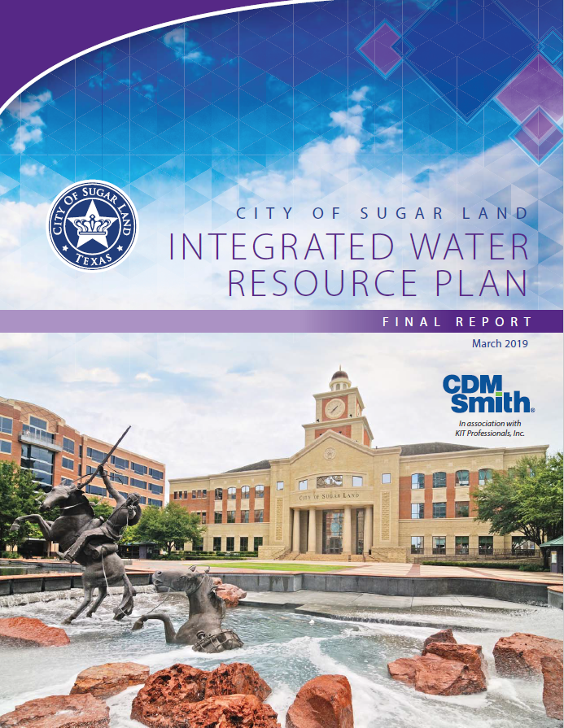

Questions? www.sugarlandtx.gov/iwrp Margo Watson mwatson@sugarlandtx.gov 346-368-4200

Slide 29
Utility Rate Study
Variables analyzed that impact the rate model
Weather (normal vs wet vs dry year)
Residential consumption impacts to revenue
Volumetric block rates
Downward trends in consumption over time
Water Loss
Raw Water Costs
Strategic Use of Fund Balances
Bond Ratings
Impact of all-in bond coverage
Five-Year Capital Improvement Program
O&M impact of CIP projects
Asset Management and Reinvestment

Slide 30
Prior Years Capital Improvement Projects
Project Start FY | Project Name | Budget | Actuals Thru 2024
2020 | Surface Water Treatment Plant Expansion | $ 495,689 | $ 258,018
2020 | Surface Water Transmission Lines | 350,411 | 141,609
2021 | Groundwater Plant SW Conversion | 200,000 | 165,380
2021 | Advanced Metering Infrastructure (AMI) | 8,025 | -
2023 | Telfair Raw Water Pump Station Rehab | 260,000 | 46,496
2024 | SWTP Rehab Ph1 - Chem Sys Replacement/Improvements | 964,000 | 147,325
Total |  | $2,278,125 | $758,828

Slide 31
FY25-29 Capital Projects
PROJECT NAME | 2025 ESTIMATE | 2026 ESTIMATE | 2027 ESTIMATE | 2028 ESTIMATE | 2029 ESTIMATE | 2025-2029 TOTAL
Surface Water Treatment Plant Expansion | $ - | $4,305,000 | $79,170,000 | $- | $- | $83,475,000
Surface Water Transmission Lines | - | 2,388,000 | 16,873,000 | - | - | 19,261,000
Groundwater Plant Surface Water Conversion | - | 1,254,000 | 11,789,000 | - | - | 13,043,000
Telfair Raw Water Pump Station Rehab | 527,000 | - | - | - | - | 527,000
SWTP Rehab Ph 1 | 6,425,000 | - | - | - | - | 6,425,000
Reclaimed Water – South of the Brazos Ph 1 | 2,783,000 | - | - | - | - | 2,783,000
North WWTP Reuse PER | - | - | - | 527,000 | - | 527,000
SWTP Rehab Ph 2 | - | 429,000 | 4,859,000 | - | - | 5,288,000
Reclaimed Water South of the Brazos – Transmission Lines Ph 1 | - | 96,000 | 1,104,000 | - | - | 1,200,000
TOTAL FUNDING | $9,735,000 | $8,472,000 | $113,795,000 | $527,000 | $- | $132,529,000

